Slide 1
Database Languages (DDL)

Slide 2
DDL (Data Definition Language)
DDL commands works on the structure of a relation only.
It includes these commands:
  Create
  Alter
  Drop
  Rename
  Truncate

Slide 3
Create (used to create a new table)
Syntax:
CREATE TABLE table_name
(
col_name1 data_type(size) constraint_name,
col_name2 data_type(size) constraint_name,
col_name3 data_type(size) constraint_name,
....
);

Slide 4
Example:
  create table student(
  RegNo number(12) PRIMARY KEY,
  Name varchar(20) NOT NULL,
  Section varchar(20) DEFAULT ‘ECE16’,
  Address varchar(50),
  CGPA number(4,2) CHECK(CGPA>5),
  RollNum number(12) UNIQUE,
  PNum number(12)
  );

Slide 5
Constraints on Create
These constraints can be applied on columns while creating a new table.
Not Null
Unique
Primary Key
Foreign Key
Check
Default

Slide 6
Not null
The column must have a value in every existing row if it not null.
Syntax:
  CREATE TABLE PersonsNotNull
  (
  P_Id int NOT NULL,
  LastName varchar(255) NOT NULL,
  FirstName varchar(255),
  Address varchar(255),
  City varchar(255)
  )

Slide 7
Unique
The Column defined as unique must a different value in every row.
Syntax:
  CREATE TABLE Persons
  (
  P_Id int NOT NULL UNIQUE,
  LastName varchar(255) NOT NULL,
  FirstName varchar(255),
  Address varchar(255),
  City varchar(255)
  )

Slide 8
Primary Key
The primary key column has not null and unique values.
Syntax:
  CREATE TABLE Persons
  (
  P_Id int NOT NULL,
  LastName varchar(255) NOT NULL,
  FirstName varchar(255),
  Address varchar(255),
  City varchar(255),
  PRIMARY KEY (P_Id)
  )

Slide 9
Foreign Key
Properties:
  It defines a relation between two tables.
  A foreign key column can have duplicate values.
Condition:
  The primary key of first table should be present in second table which will act as a foreign key in second table.
  Every value in foreign key column should be present in the first table primary key.

Slide 10
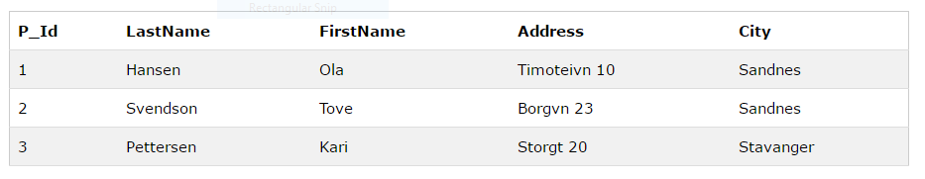
Example: we have a Persons table
Primary key id P_ID
This column is present in orders tables acting as a foreign key.

Slide 11
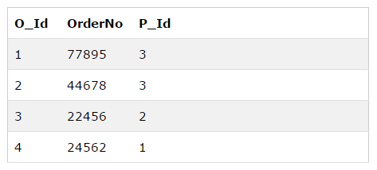
This is Orders table
You can see that P_ID column in orders table is having only those values which were there in persons table.

Slide 12
Syntax:
  CREATE TABLE Orders
  (
  O_Id int NOT NULL PRIMARY KEY,
  OrderNo int NOT NULL,
  P_Id int FOREIGN KEY REFERENCES Persons(P_Id)
  )

Slide 13
Check
Apply validations to column to match every value entered with the check condition, whether it is valid (correct) or not.
Syntax:
  CREATE TABLE Persons
  (
  P_Id int NOT NULL CHECK (P_Id>0),
  LastName varchar(255) NOT NULL,
  FirstName varchar(255),
  Address varchar(255),
  City varchar(255)
  )

Slide 14
Default
To set a predefined value.
Syntax:
  CREATE TABLE Orders
  (
  O_Id int NOT NULL,
  OrderNo int NOT NULL,
  P_Id int,
  OrderDate date DEFAULT GETDATE()
  )

Slide 15
Alter (To add a new column)
Syntax:
  ALTER TABLE table_name ADD
  (
  column_name1 data_type(size),
  column_name2 data_type(size),
  column_name3 data_type(size),
  ....
  );
Example: alter table student ADD subject varchar(20);

Slide 16
Alter (To Drop a column)
Syntax:
  ALTER TABLE table_name DROP
  (
  column column_name,
  );
Example: alter table student DROP column subject;

Slide 17
Alter (To modify existing column)
Syntax:
  ALTER TABLE table_name MODIFY
  column_name new_data_type(new size);
Example: alter table student MODIFY section char(20);
Syntax:
  ALTER TABLE table_name MODIFY
  column_name new_data_type(new size) NULL/NOT NULL;
Example: alter table student MODIFY section char(20) NOT NULL;

Slide 18
Alter (To add or drop a primary key)
Syntax:
  ALTER TABLE table_name ADD
  Primary key (column_name);
Example: alter table student ADD PRIMARY KEY(RegNo);
Syntax:
  ALTER TABLE table_name DROP
  Primary key;
Example: alter table student DROP PRIMARY KEY;

Slide 19
Alter (To rename a column)
Syntax:
  ALTER TABLE table_name RENAME
  COLUMN old_column_name TO new_column_name;
Example: alter table student RENAME COLUMN Section TO Sec;

Slide 20
Drop
Syntax:
  DROP table table_name;
Example: Drop table student;
Rename
Syntax:
  RENAME table_name TO new_table_name;
Example: RENAME student to std;
Truncate
Syntax:
  TRUNCATE table table_name;
Example: TRUNCATE table student;

Slide 21
A scenario
Consider a schema of table
Employee(emp_id, ename, dept_id, email, mobile_number, join_date, salary, mgr_id, city)
Apply the constraints on this table
Select the appropriate primary key
Choose data types for all columns.

Slide 22
Questions on scenario
Add two new columns pincode and state.
Change the data type of any two columns.
Drop the primary key.
Add a primary key of two columns.
Rename the table
Perform drop and truncate.

